Slide 1
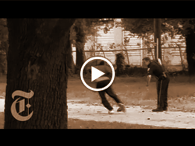
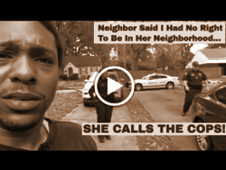
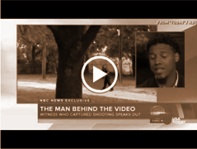
Santana Initiative’s
Guide to Recording Video
Becoming Proficient in Using Mobile Video
to Document Public Events Including
Voter Protection and Encounters with Law Enforcement
By the Multicultural Media, Telecom and Internet Council

Slide 2
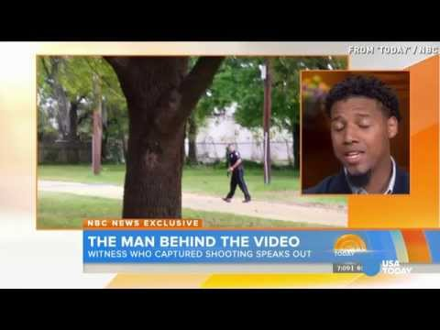
Feidin Santana’s Story:
“We are here to be each other’s keepers.”
If not for the witness who filmed the shooting of Walter Scott, his family might never have known what happened.
Result: The officer received a sentence of 20 years behind bars, plus two years of supervision after his release. - NBC News.

Slide 3
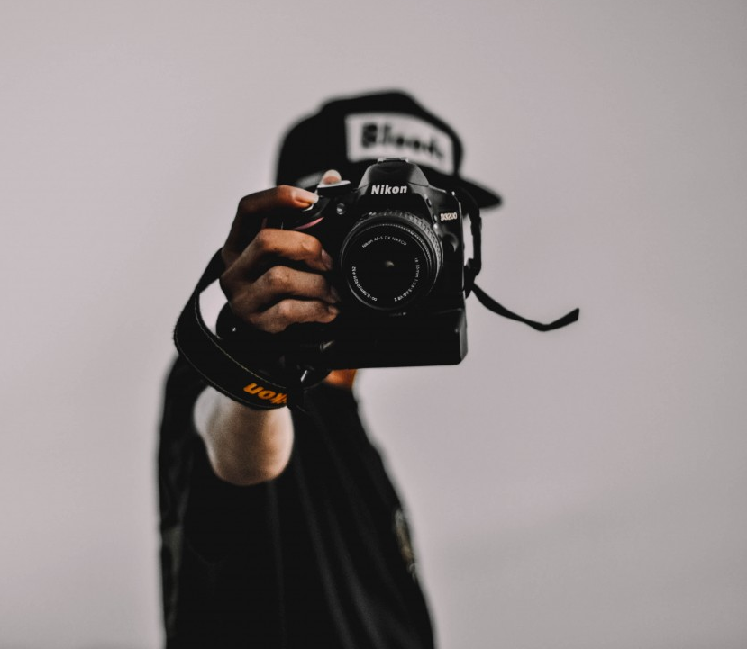
Video can advance social justice.
Social Justice (via video recording) arises as a check on:
Voter intimidation,
Police misconduct, and
Immoral civilian activity, among other things.
We each have this power now in our pockets, and we can use it to overcome discrimination and structural inequality.

Slide 4
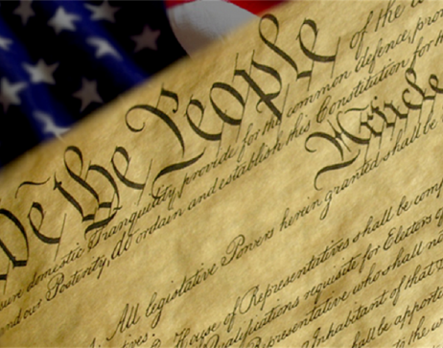
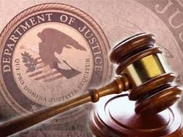
The U.S. Department of Justice Agrees.
While there is no uniform federal law or Supreme Court decision governing the recording of on-duty police activity, the U.S. Department of Justice has issued an advisory letter (May 14, 2012), stating that non-intrusive, respectful videotaping of police officers in a public setting is protected by the First Amendment.

Slide 5
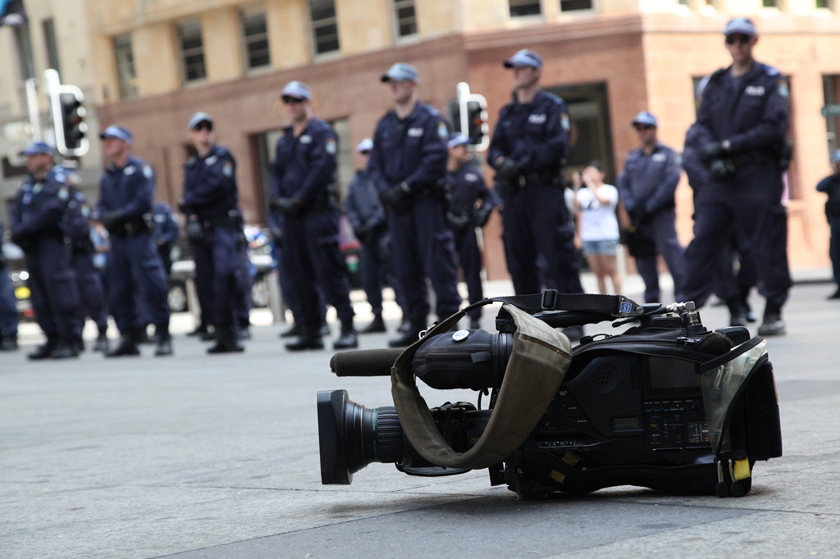
Simply knowing that you are being recorded:
Can result in heightened levels of accountability,
Protects parties involved by providing evidence,
Reduces misconduct, and
Can save lives.

Slide 6
Yes, there are obstacles.
Civilians videotaping the police have been victims of charges under laws of general applicability, such as:
Obstruction of justice
Disobeying an officer
Obstructing an investigation
Interfering with an officer
Failure to obey an officer
Disorderly conduct
Resisting arrest
Obstructing a street
Harassment

Slide 7
What the DOJ Has to Say
“Private individuals have a First Amendment right to record police officers in the public discharge of their duties, and that officers violate individuals’ Fourth and Fourteenth Amendment rights when they seize and destroy such recordings without a warrant or due process.”
- DOJ Letter, page 2.

Slide 8
What the DOJ Has to Say
These individuals have:
“...a right to record in all traditionally public spaces, including sidewalks, streets, and locations of public protests” and also on private property such as a residence.
- DOJ Letter, page 4.

Slide 9
What the DOJ Has to Say
“These rights, subject to narrowly-defined restrictions, engender public confidence in our police departments, promote public access to information necessary to hold our governmental officers accountable, and ensure public and officer safety.”
- DOJ Letter, page 1 (emphasis added).

Slide 10
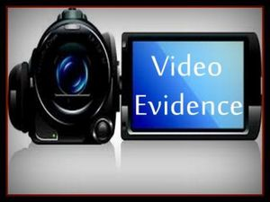
The Santana Initiative’s
Guide to Recording
Examples of Why We Should Record Confrontations
Responsibly Recording Confrontations
Tips For Higher Quality Videos
Sample Scenarios and Responses
MMTC’s Online Resources

Slide 11
Examples of Why We Should Record Confrontations:
A video answers questions and provides evidence.

Slide 12
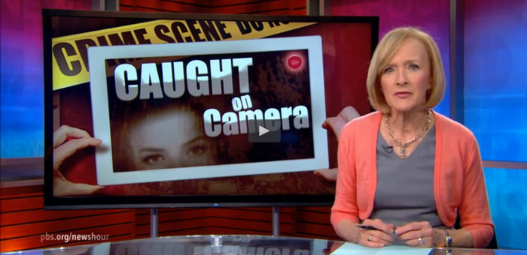
Why Record?
Any encounter with another person over a suspicion or disagreement could escalate. Recording protects all parties involved.
It captures illegal conduct when it occurs, giving credibility to a Section 1983 claim or other civil/criminal action.
It protects parties from false allegations if a party acted responsibly.

Slide 13
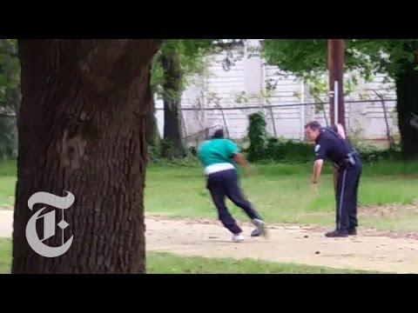
Walter Scott Video: Feiden Santana, a witness to the scene above in South Carolina, recorded the event from a safe distance.
Questions answered: Was deadly force necessary? Did the officer lie about what happened? Was this murder? This video was the reason the officer was convicted for murder.

Slide 14
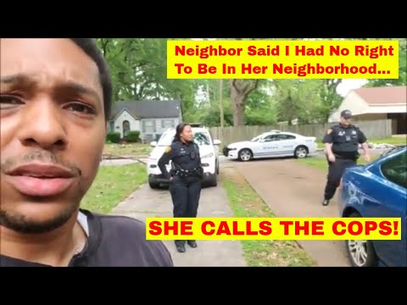
CNN covered the story. Michael Hayes is an investor who goes to houses and checks them whilst taking photos. This time, a neighbor came out shouting that he had no right to be there, in spite of his sign and cooperation. She called the police, and the video captured everything. Here, we had a happy ending. The video is a good example of recording confrontation while attempting de-escalation.

Slide 15
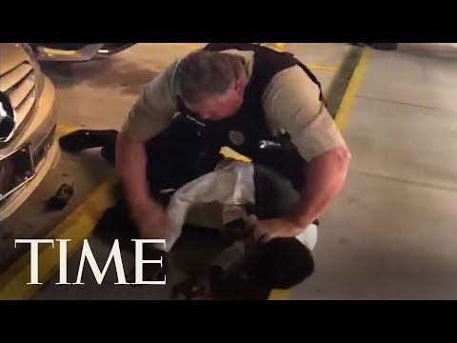
“After 22-year-old Anthony Wall escorted his 16-year-old sister to the prom on Saturday, the two decided to go to a Waffle House for a bite to eat. Wall said he got into an argument with several wait staff members and police were called.” - Diversity, Inc.
Was there unnecessary force here? Profiling? Abuse? This video appears to have been lawfully recorded. It will serve as evidence.

Slide 16
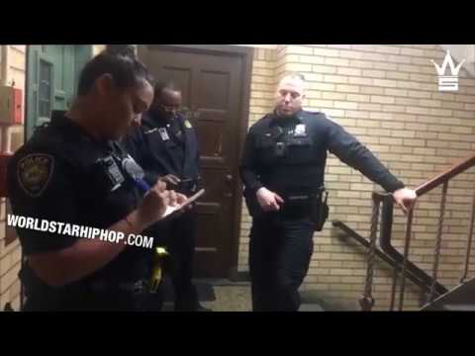
“A black graduate student at Yale who fell asleep in her dorm common room said she had a disturbing awakening this week when a white student flipped on the lights, told her she had no right to sleep there and called the campus police.”
- New York Times
Did any law require her to present ID or her name? Was she profiled?

Slide 17
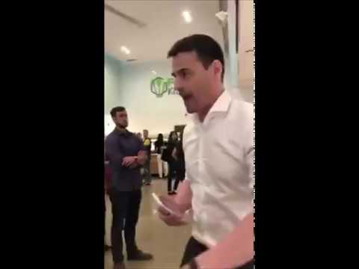
Here is an example of a video that has created a firestorm reaction online to a New York lawyer’s recent comments.
How could this video have been better? What about the actions of the videographer? Did the video lead to de-escalation? Did the lawyer see that he was being recorded? Did that help?

Slide 18
In every one of these videos, at least one person’s interest was protected by the video’s existence.
But what about all of the times there has not been a video?
What if we had a video when George Zimmerman shot Trayvon Martin?
If it is possible to record lawfully, do it.

Slide 19
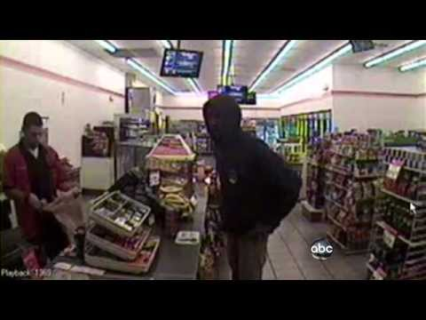
In the Zimmerman case, we learn in this video to the right that there was store camera footage from 7-Eleven showing Martin prior to the shooting, Zimmerman’s 911 dispatcher call, and 911 calls that came from neighbors.
There was no videotape of the actual incident. This case would have been easier if the 80 seconds of “lost time” had been video recorded.

Slide 20
Responsibly Recording
Remember, this is general guidance. You should check your state’s laws and regulations to ensure complete compliance with the law. You may learn more from:
MMTC’s FAQs from the Santana Initiative

Slide 21
Avoiding Unnecessary Confrontation:
Do not interfere with the police officers in the performance of their duties;
Do not violate any section of the law, ordinance, code, or criminal or traffic article; or
Do not cause another person to break the law.
*Though officers on duty don’t have a reasonable expectation of privacy, you should avoid recording in a secret manner.

Slide 22
Avoiding Unnecessary Confrontation:
If you are clearly in a public place, then the police or whoever is being recorded has no reasonable expectation of privacy, and the law generally does not require consent to record.
If the setting is or could be private, you should acquire the proper consent as defined by your state wiretap/eavesdropping statute(s).
(More on what “proper consent” is in the following slides)

Slide 23
Understanding Consent and Its Limits
Federal Law (One-Party)
One-party v. Two-Party
Expectations of Privacy

Slide 24
One-Party Consent
Under federal law, and in a one-party consent state, you may record your own interactions, including those with police as they are discharging their duties under the law, whether or not you are in a public area or the police know you are recording.
Generally speaking, you may record interactions between the police and a third party in a public place (or a private space where you have a right to be) if your camera is in plain view.

Slide 25
Two-Party Consent
In a two-party consent state, you must obtain the consent of ALL PARTIES to record a private conversation.
Generally speaking, even in two-party consent states, you may record interactions between the police and a third party in a public place (or private place where you have a right to be) if your camera is in plain view.
This is the case so long as none of the parties have a reasonable expectation of privacy.
You should expressly announce state that you are recording, rather than hiding it or otherwise attempting to record surreptitiously

Slide 26
In Public
Generally speaking, you may record interactions in public spaces without consent without violating state wiretapping and eavesdropping laws.
This is because, in a public setting, people generally do not have a reasonable expectation of privacy.
But, there are exceptions (e.g., a conversation in a coffee shop where the parties to the conversation are huddled in a corner whispering)

Slide 27
Expectation of Privacy
What is public?
Any space that is not private.
Public spaces traditionally include sidewalks, streets, public parks, etc.
What is reasonable?
Courts evaluate based upon both the individual’s actual expectations and whether society recognizes that expecation as reasonable
Generally speaking, if conduct is occuring in a public space, it is acceptable to record, subject to state consent laws.
Recording in public is not “secret” if in plain view.

Slide 28
Common Scenarios
These are common scenarios that may occur along with possible responses.
The goal here is to stay out of jail, even if you have a right to be recording video. You may file a complaint afterward.

Slide 29
Scenario: An officer asks you to STOP recording.
Possible Response/Action:
In a one-party consent* state: “Respectfully Officer, the state law only requires the consent of one party in a conversation. If I am not interfering with your work, I’m allowed to continue recording.”
In an all-party consent* state: “I’m aware of the law, however, courts have ruled that it doesn’t apply to on-duty police officers in public places.”
If the officer insists, stop recording. You may file a complaint later.
*It is critical that you check your state’s consent laws before you record.

Slide 30
Scenario: An officer asks you to DELETE your video.*
Possible Response/Action:
You may say, “I am under no legal obligation to delete anything from my phone.”
*Remember that the United States Supreme Court ruled in Riley v. California that police may not search your cell phone without a warrant.

Slide 31
Scenario: An officer threatens to ARREST you.
Possible Response/Action:
Stop recording.
Believe it. Be calm, polite, and compliant.
“I will turn off my [camera], but I am doing so under protest.”
You may file a complaint afterward.

Slide 32
What You May Do in a Traffic Stop
First, be polite and calm.
The nature of the pullover will come up as a topic. An officer may or may not write a citation. When the time is right, you may ask, “Am I free to go?” This is an important question if the officer doesn’t have anything to write a citation for, such as during a road checkpoint.
If the answer is no, then you are being detained.
You should then ask, “Officer what crime am I suspected of committing?”

Slide 33
Tips For
Higher Quality Videos
These are techniques that will go a long way in improving video quality.

Slide 34
Q: What should you use?
A: Live Feed Applications.
Here is a list of popular live feed applications:
Facebook Live
Periscope
Bambuser
YouTube
Other applications that protect your camera photos and videos:
Private Photo Vault
Photo Vault

Slide 35
Recording Broadcast-Ready Citizen Footage
Remember that you have a First Amendment right to record police officers engaged in the public discharge of their duties, so long as you (1) do not interfere with the police, (2) abide by other reasonable restrictions as to the time, place, and manner of your recording, and (3) comply with applicable state laws regarding recording of audio.
Don’t edit the raw video. It is better to not have gaps where people speculate what happened.

Slide 36
Video Definition
You can have a clearer shot by simply moving in closer. The zoom feature on cameras typically do not help definition. If you want to zoom in, the best practice is to walk closer to the subject of the recording.
*BUT REMEMBER* Do not interfere with official law enforcement action or duties, or your right to record may become void. Stay a safe, respectable distance away from the ongoing event, unless of course you are a part of it.

Slide 37
Video Definition, continued...
Ensure that your video quality settings are set to the highest possible. If you have frame per second (fps) options, set those to the highest possible. That makes the video smoother.
Make sure your lens is clear of smudges or debris.

Slide 38
Should you shoot vertical or horizontal?
Landscape (horizontal) is always preferable to portrait (vertical).
You can still record what is going on, and you can capture what is happening around the scene better. If you need to focus on more than one person, you will not be shifting from one person to another as they speak.
You will have more people who are involved in the frame.

Slide 39
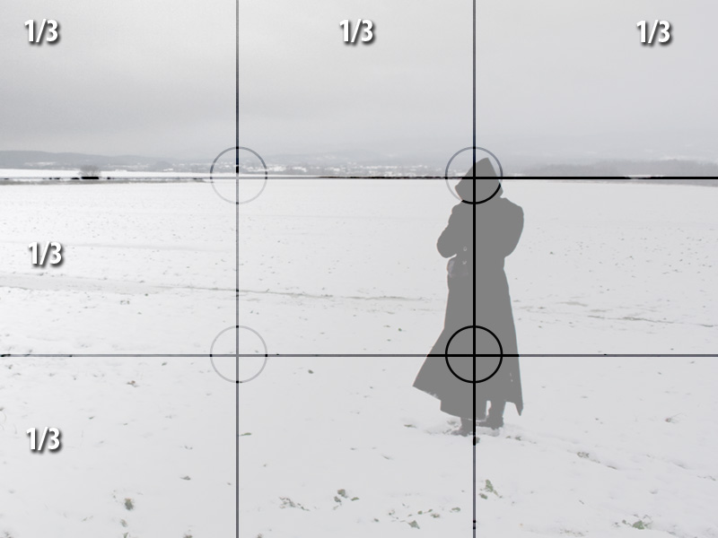
Rule of Thirds
Try to use “rule of thirds” as shown to the right to place the empty space of the frame where the person(s) of focus are moving or looking.
Keeping your photo framed correctly will avoid having to move it around too much, and viewers’ focus will follow better.

Slide 40
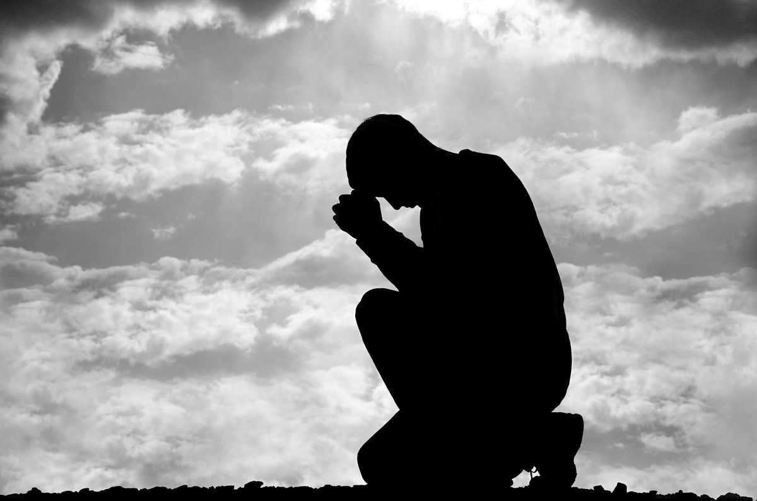
Video Definition
Whether during the day or the night, try not to have a bright light (such as the sun or a street lamp) directly behind the people you are recording. The stronger the light is, the more likely a silhouette will result.
If possible, make sure there is enough light on the front of the people in the video. You can do this by moving yourself around to a different angle.

Slide 41
Steadiness
Almost no one has a tripod handy in the kinds of scenarios we are discussing.
However, you may still find substitutes by resting the phone or camera on a flat surface or attempting to keep a steady hand while holding it. Use both hands.

Slide 42
Focus and Exposure
Most phones and cameras allow you to use manual focus by tapping on the part of the screen you want to focus on. This may also adjust the lighting. If the video is largely action-based, you will want to have enough light coming into the iris of the camera to record what is happening. This may especially be a problem at night or in low-light settings.
Note: Some phones can lock on a manual setting. Check your phone for this setting in order to avoid your phone autofocusing.

Slide 43
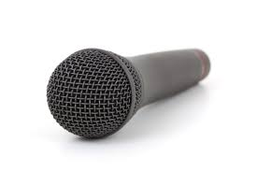
Audio
There’s not much one can do in the case of spontaneous recording without a windscreen and the choice between an omni-directional (surround sound) or mono-directional (directed) mic.

Slide 44
Audio, (continued)...
What you can do at minimum, however:
If there is wind, place yourself between the wind and the mic to shield it from too much wind noise.
Make sure the mic is not covered by one of your hands as you’re holding the cell phone or camera.
Most cell phones and cameras have omnidirectional mics by default. Don’t worry about pointing the mic at the person as much as on framing your video shot well.

Slide 45
More information on recording mobile video of civil rights violations and the state laws on levels of “consent to record private conversations” can be found in MMTC’s FAQs from the Santana Initiative, posted on MMTC’s website,
www.mmtconline.org. NOTE: This PPT is for informational use only. It does not constitute legal advice and should not be used as such.

